Slide 1


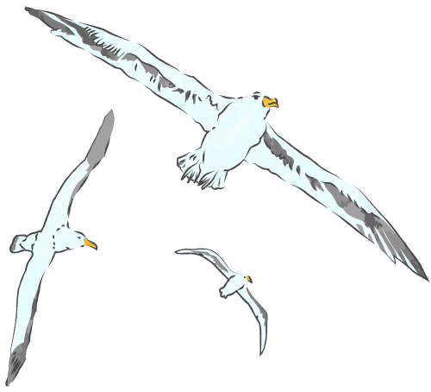


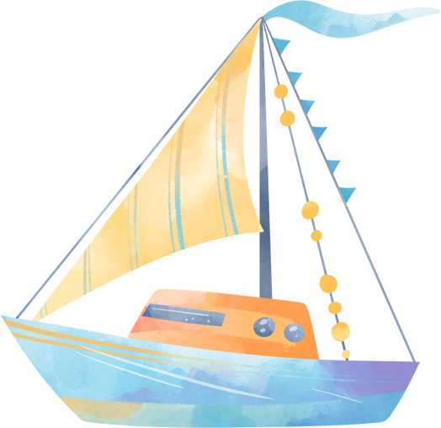

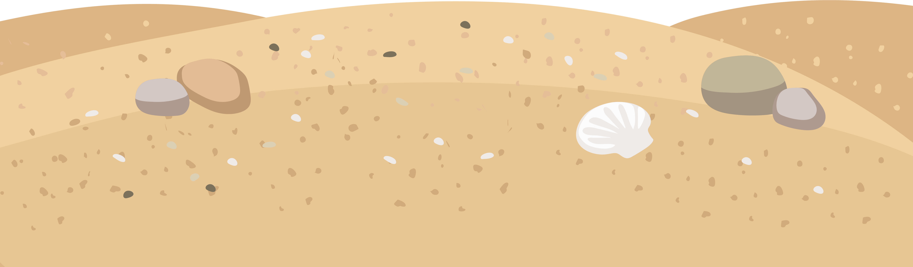

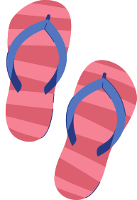

SUMMER
HOLIDAYS
In Mallorca, Spain

Slide 2
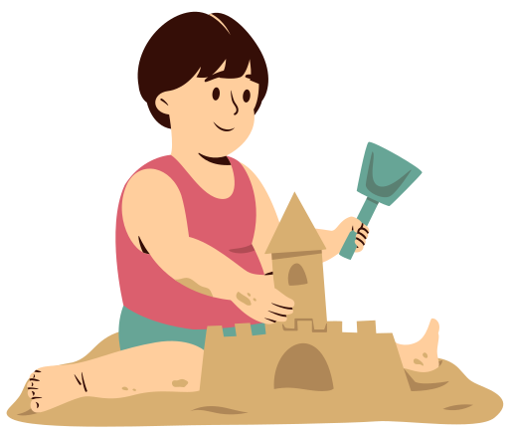
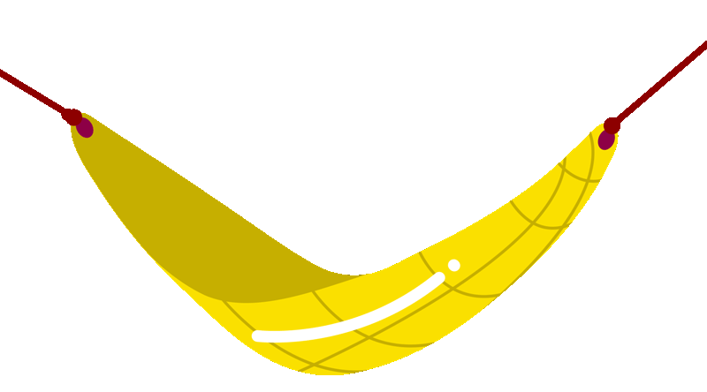
INTRODUCTION
Present 🫵 🙋 Summer Holidays

Slide 3
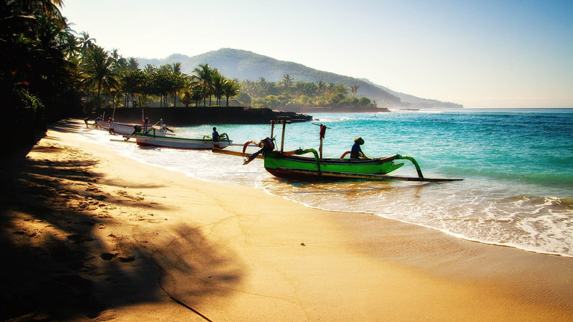
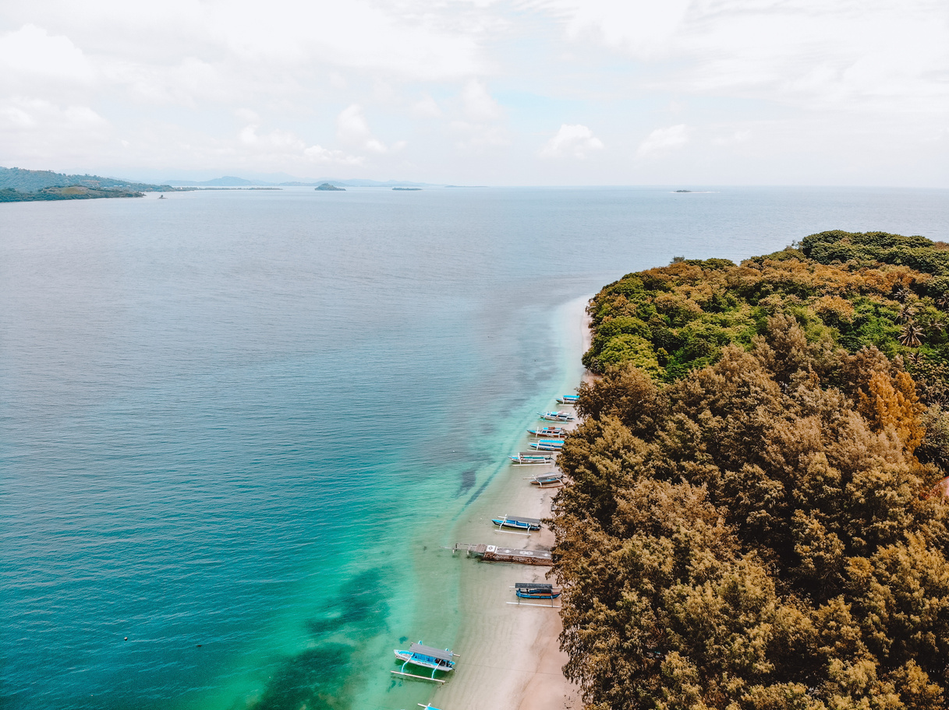

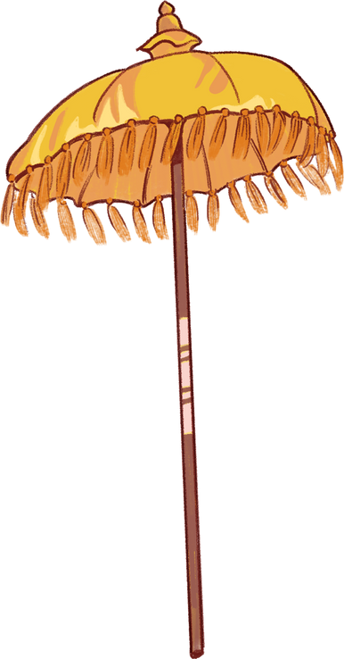
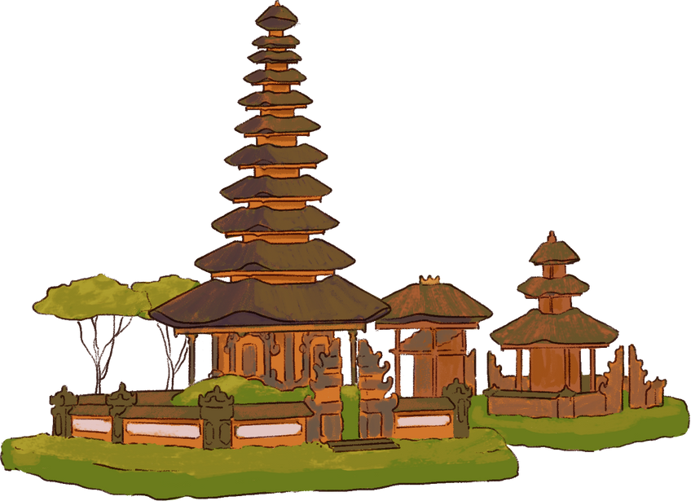
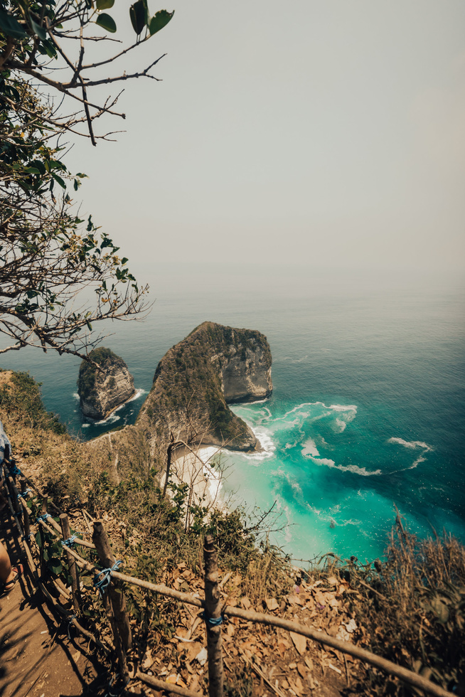
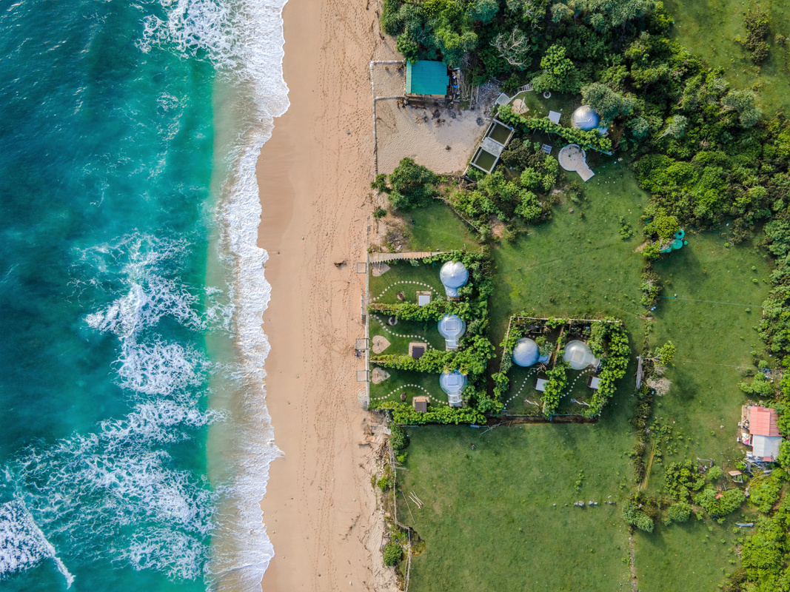
yes i replace pronouns withcharacters and emojis
DESTINATION 1
Mallorca, Spain
WHERE ? ⬆️

Slide 4
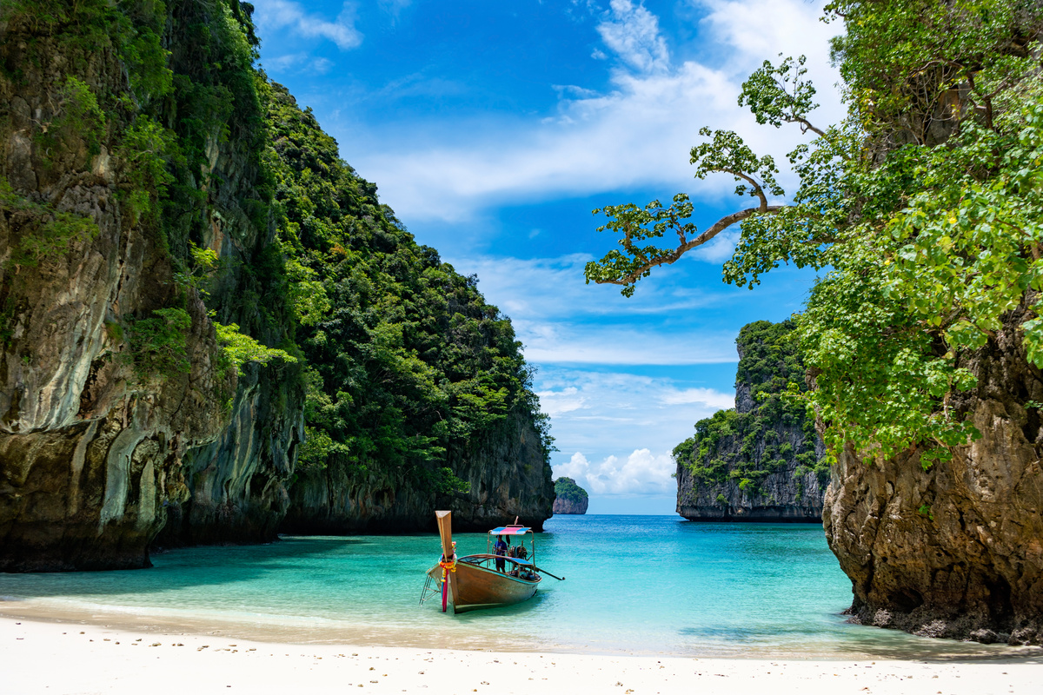
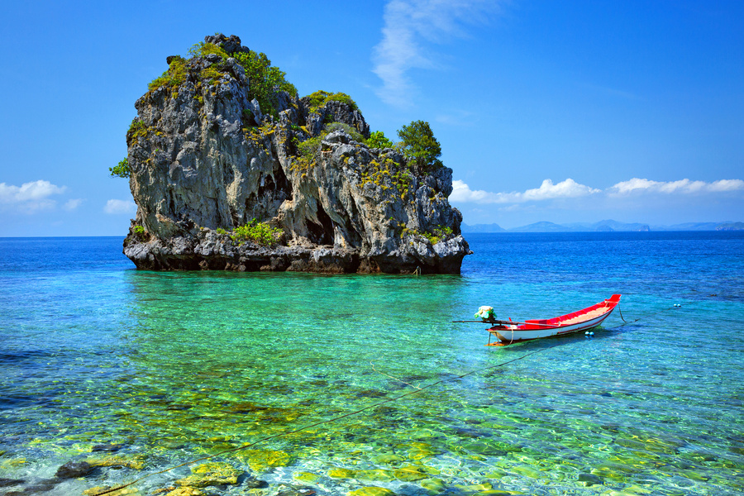

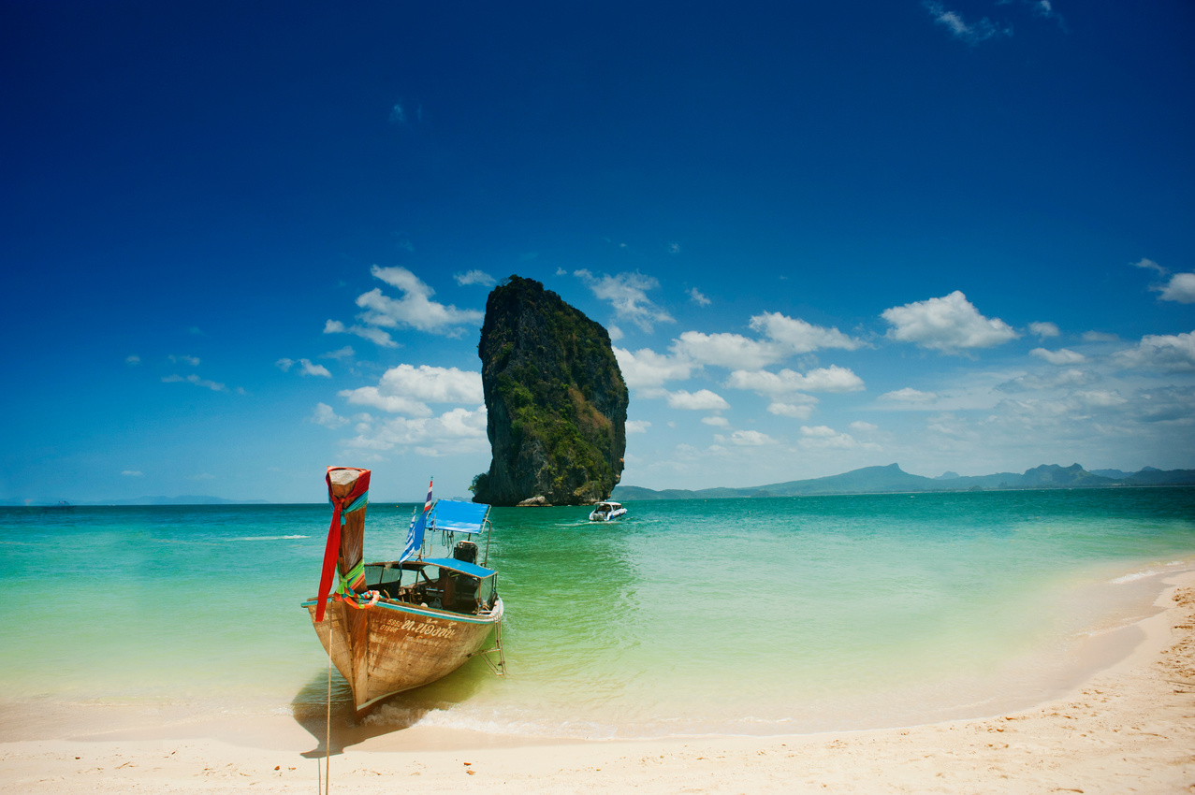
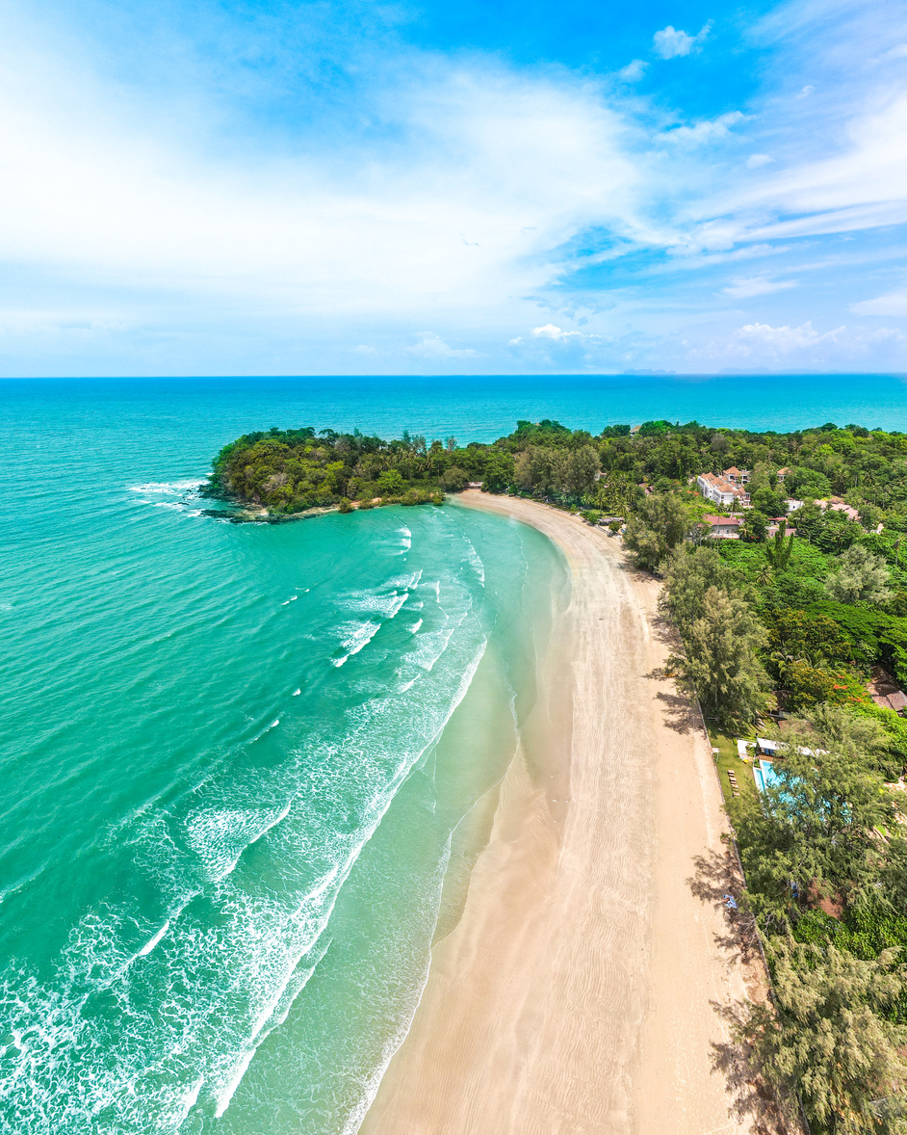

yes i replace pronouns withcharacters and emojis
When ?
➡ In october, 2024

Slide 5
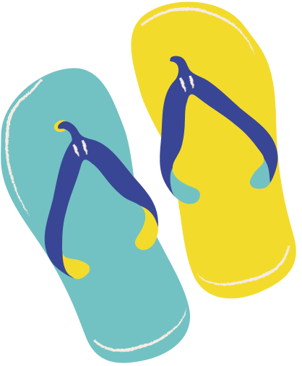
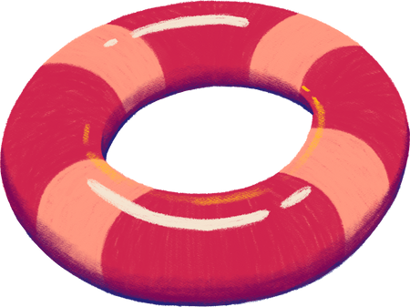

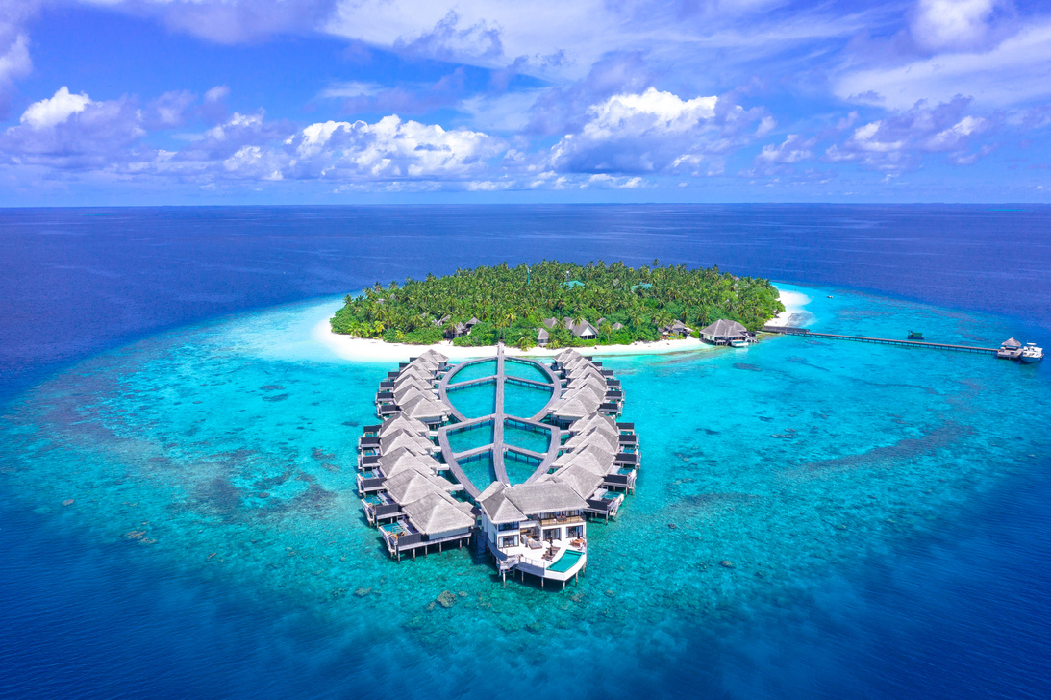
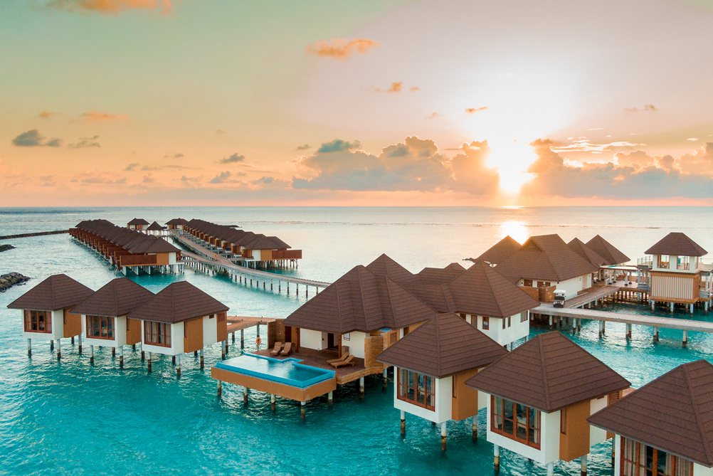

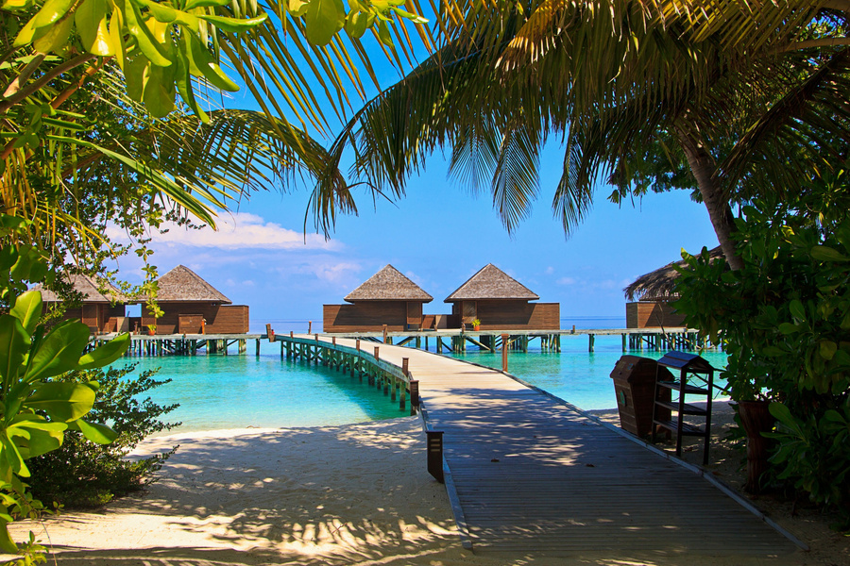
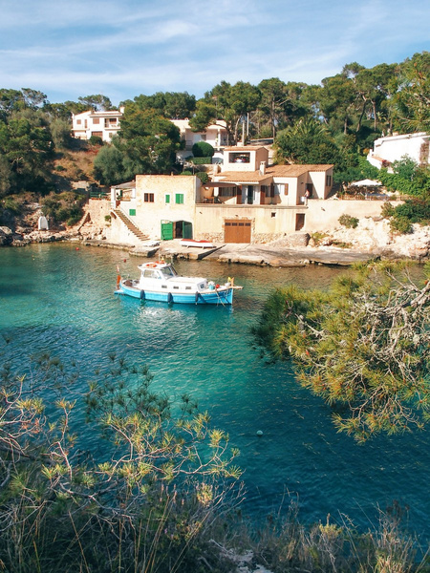

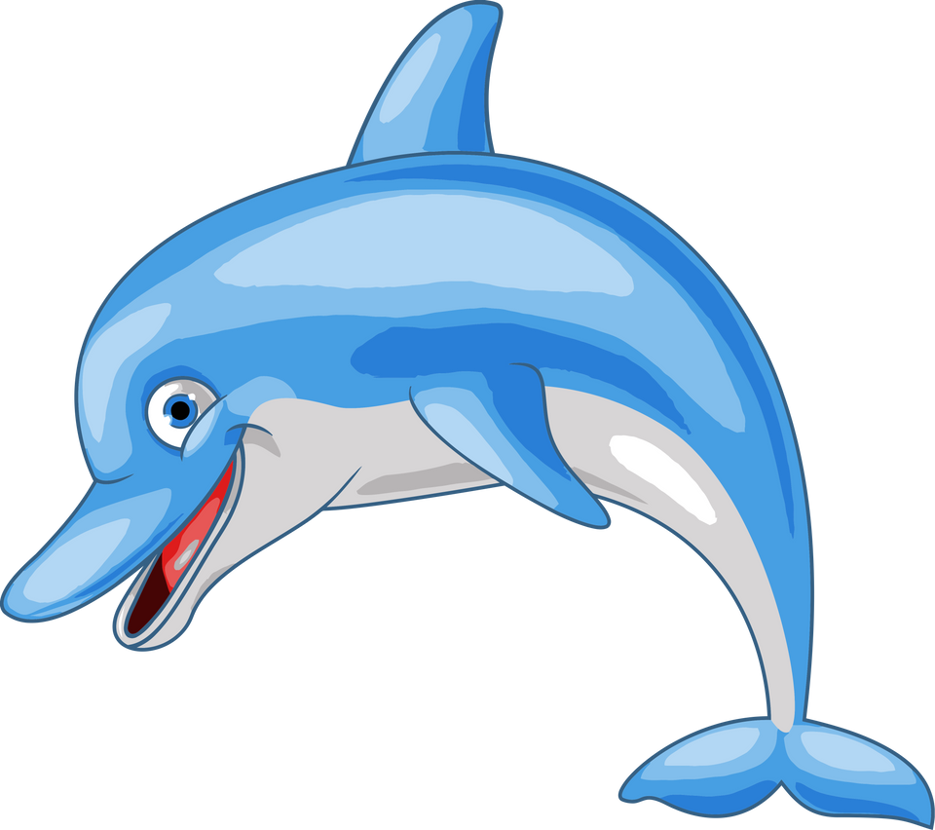
For how long?
stayed 📍for 1 week

Slide 6
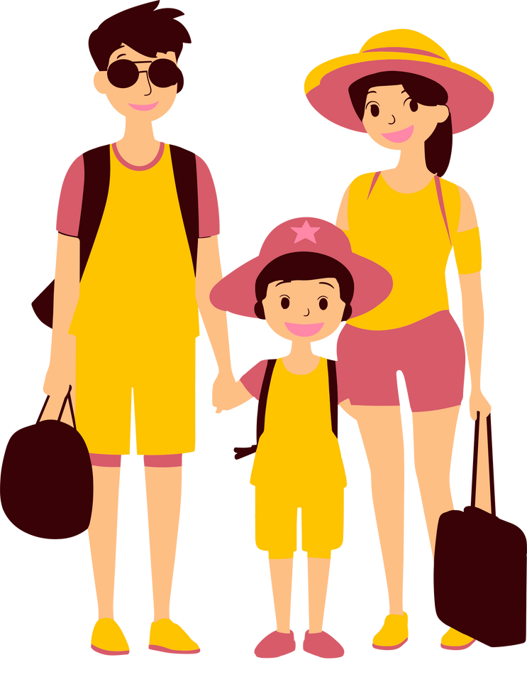
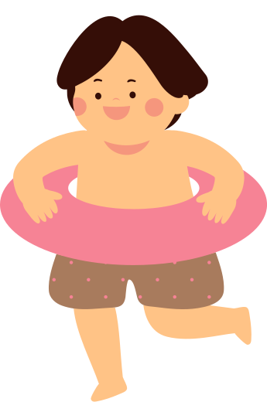
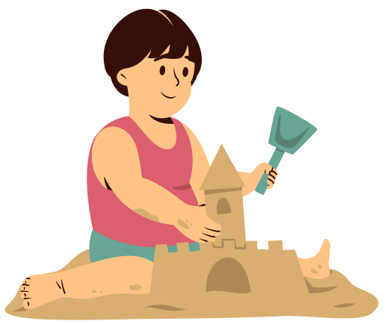
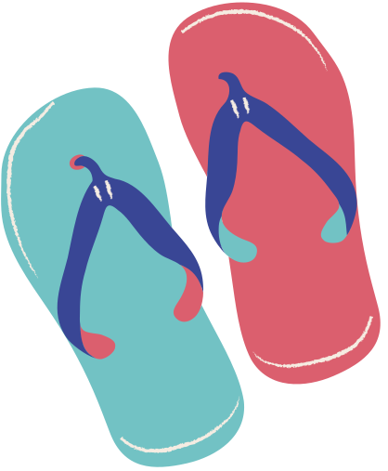
yes i replace pronouns withcharacters and emojis
WHITH WHO ?
AND THE WEATHER?
I🧳 with 🙋‍♂️ grandparents

Slide 7
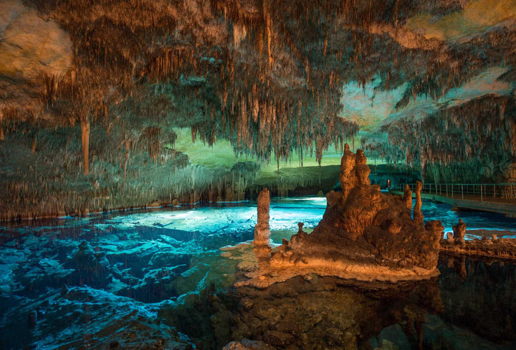
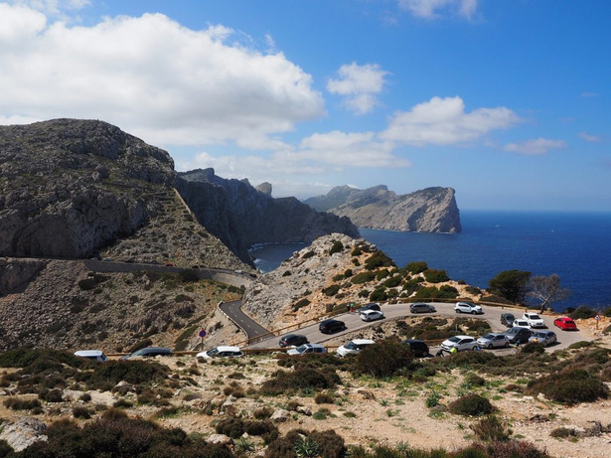
What did I do?
👪> Drach Caves
IN-CRE-DI-BLE
👪 walked in the mountains
👪spend time 🚶‍♂️by the sea

Slide 8
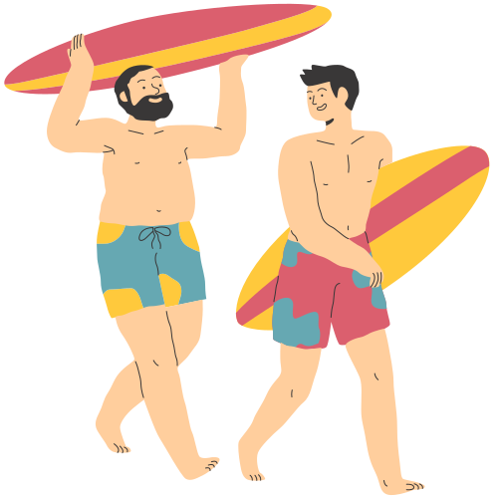

WHAT DIDN'T I DO?
🙋‍♂️ wanted to try surfing
i did’nt have 🍀 to do it

Slide 9
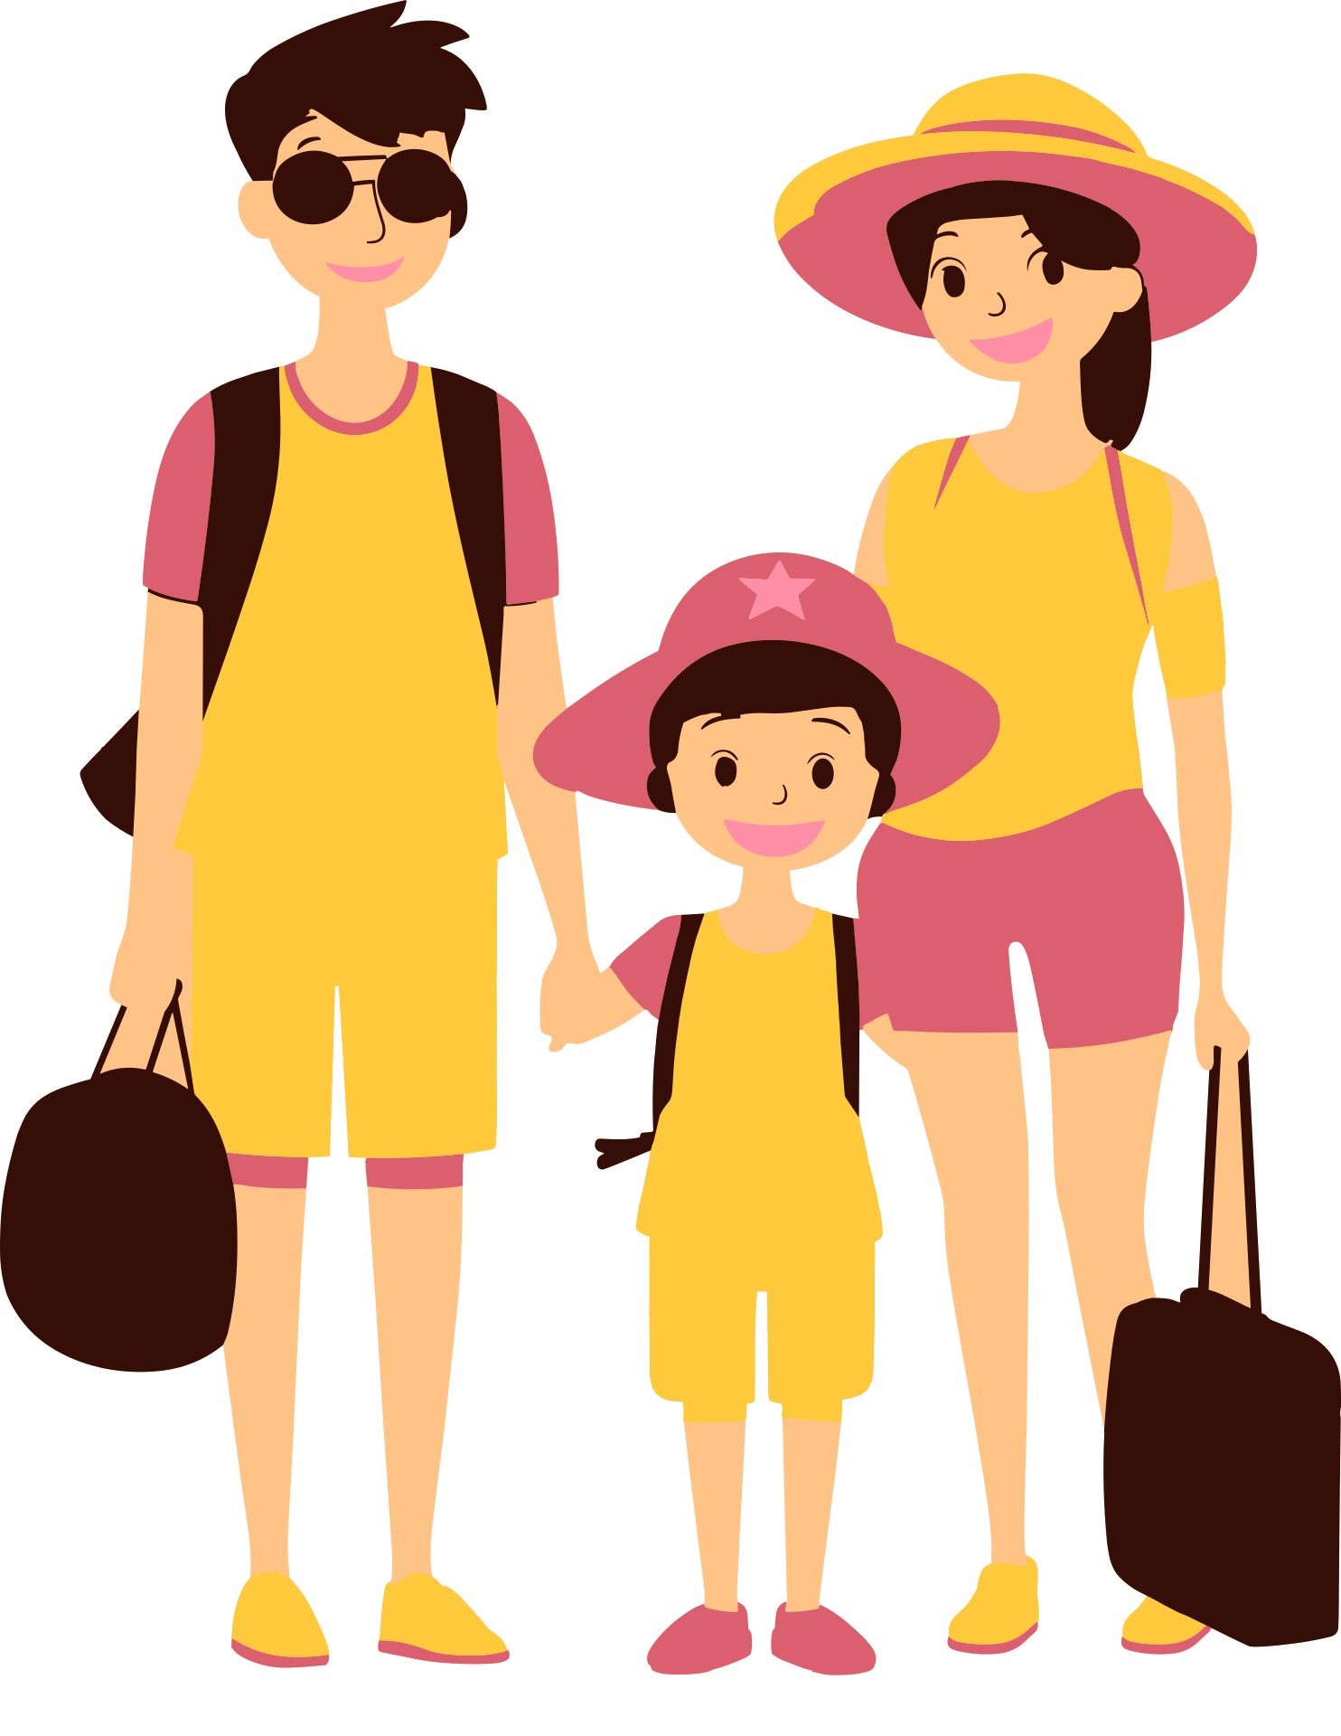
THE WEATHER
The weather
very 👍
👪could see
🟦sky
it was
🥵

Slide 10


CONCLUSION
I very 🩷 this 🧳. 🙋‍♂️ did many
I wait > my next holidays....
Thanks for watching !😉

